Slide 1
Uttarakhand Public Works Dept.
WELCOME
Two Days Work shop on Contract Management
5-6 January 2024
Dehradun

Slide 2
I am Dr. Sridhar Mothe. I am Civil Engg graduate from OU , M.Tech. (IITM) and Ph.D in contract management . Did LLB and PGD ADR from NALSAR.
With 35 years of experience in construction industry (20years in Govt , 15 years Private) - presently retired and a consultant .
From past 15 years -teaching contract management as a subject as a visiting faculty to various premier teaching and training institutes for academic courses and trainings
Authored a book “ Infrastructure Contracts and Management” available at https://www.amazon.in
Opened a You Tube Channel : https://YouTube.com/@InfraContractsGuru

Slide 3
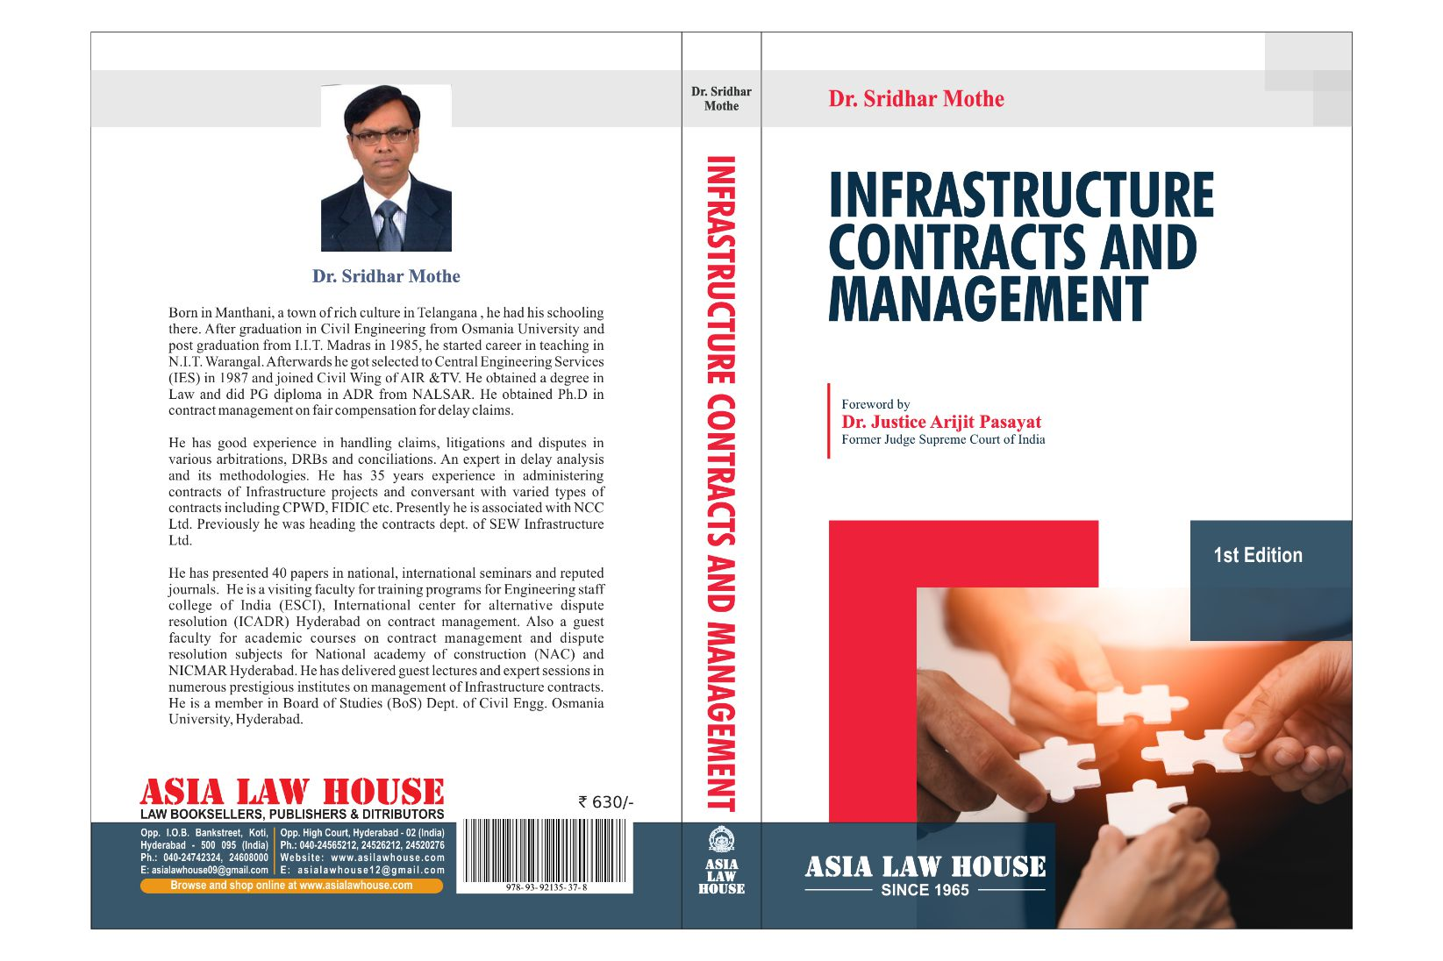

Slide 4
Work shop Sessions :
1. Salient features of Construction Contracts & Important terms & conditions of contracts GCC
2. Formation of Contracts &Types , Legal Principles , Contract Act
3. Standard Form Contracts, Uttarakhand PWD , Imp Clauses
4. Contract Administration Principles , Records , Documentation
5. Contractual Obligations, Performance, Time lines, EOT issues
6. Claims , Disputes resolution, ADRs , Arbitration
Case Studies, Trivial Issues & Interactive Session

Slide 5
Topics Covered :
General terms in GCC , Standard form contracts, Overview FIDIC, CPWD, Uttarakhand PWD , Legal issues & Principles
Important provisions of Indian Contract Act , Substantiation , documentation , correspondence , site records
Contractual obligations, Performance , Time lines , Work program , EOT issues, Delay analysis , UK SCL Protocols
Claims, Disputes , Dispute resolution process, ADRs, Conciliation , Mediation Act 2023
Arbitration , Process, Procedure, A&C Act 1996 - Imp provisions Types of Arbitrations , Institutional arbitration

Slide 6
Topics Covered : (Contnd)
Avoidance of disputes , ambiguities & resolution , settlement of disputes , Limitation aspects
Construction Law and Statutory Compliance aspects
LDs, Penalties , Breach and damages , Termination
Excepted matters, Time as essence , Provisional EOT
Undertakings , No claim certificates , Force majeure
Measures for improving productivity ( Pre contract management, Post award contract administration )

Slide 7
Introduction
Construction / Infrastructure Contracts are different from contracts for sale of goods
‘Product made and sold ‘ analogy different from manufacturing sector
Contract document executed & signed by parties for Infrastructure projects in different formats
Normally consist of voluminous documentation and not just work orders

Slide 8
Introduction
In simple form in item rate contract the documentation
- LOA
- Conditions of Contract (GCC , SCC)
- Tech Spec
- Priced BOQ
Govt depts follow standard conditions – Standard form contracts

Slide 9
General Terms and Conditions
Definition of Terms
Instructions to bidders (ITB) , Bid data
Conditions on Commercial / Financial aspects
Performance Guarantee
Retention to be effected from bills
Security deposit
Mobilization advance
Secured advance ( material advance)

Slide 10
General Terms and Conditions
Payment terms / Bill certifications
Deviation limit
Variations , Extra , Substituted items – Valuations
Price Variation provisions ( Escalation)
Time period and Timelines ( mile stones if any)
Extension of Time period
Liquidated Damages
Defect liability and Performance obligations

Slide 11
General Terms and Conditions
Force majeure events, Hindrances
Notifications , Claims
Termination , default events
Dispute Resolution procedure
Statutory provisions , wages, labour regulations etc.
Taxation, Insurance provisions
Special Conditions of Contracts
Hierarchy or Precedence of documents

Slide 12
Precedence of Documents
In case of ambiguity / discrepancy between different set of documents the precedence or hierarchy is agreed
Contract agreement
Letter of acceptance
Special conditions ( SCC)
General Conditions ( GCC )
Employer’s requirements
Tender Drawings
Priced BOQ
Tech Spec.

Slide 13
Types of Contracts
Item rate
Percentage rate
Design and build
EPC ( Engg Procurement Construction)
LS and Turnkey
Cost Plus
PPP Model ( Public Private Partnership)

Slide 14
FIDIC Contract Conditions
FIDIC is an acronym for French name – Federation Internationale Des Ingenieurs -Conseils
International Federation of Consulting Engineers located in Geneva , Switzerland
Organizes Conferences, training courses on Contracts
Publishes contract terms and conditions as international standards for different contract models
Consists of three parties in contract and widely used because of fair, balanced and equitable approach

Slide 15
FIDIC Contract Conditions
FIDIC has effective dispute resolution mechanism and also procedure to avoid and curtail disputes
Each type of contract conditions is a colour coded like Red book for item rate contracts,
Silver – EPC ; Yellow book - Plant , design and build Consultancy agreements- White ; Gold – Design build operate and Blue, Green books etc.
Most of the last editions of FIDIC were in 1999 and recently in 2017 revised suites were published.

Slide 16
Other model contract conditions :
NEC (New Engineering Contract ) conditions by Institution of Civil Engineers , UK used in UK, Newzeland and Australia
JCT ( Joint Contract Tribunal) UK Standard form conditions for building projects
Tip : Advised to Study Conditions of Contracts for different models : comparison and contrast

Slide 17
For any support / help in management of Infrastructure Contracts you can reach me :
srimothe@gmail.com
THANK YOU!

